Slide 1
Evaluating the Impact of Wearable Watches on Fitness
Daniel Guillen Montano
Diego Alvarado

Slide 2
Why Fitness is Flourishing
Boom of fitness world:
Key Fitness Industry Statistics
The Principal trend
Wearable trends
Population engaged in USA is increasing.
22, 4% of men and 19,9% women 2023.
Boom in COVID time.
https://www.statista.com/statistics/189562/daily-engagement-of-the-us-poppulation-in-sports-and-exercise/#statisticContainer
Women has increased 32.2%, compared to a 23.2% of men.
sporting goods sales surged from $22.6M to $40.5M, marking a robust 38.93% growth.
https://www.ptpioneer.com/fitness-industry-statistics/
Digital Fitness Technology 79 B. in 2026.
Fitness wearable the principal trend
Smart Wearable is 86.7 millions of users.
https://onix-systems.com/blog/top-trends-that-will-impact-digital-fitness-industry

Slide 3
The Purpose
Project purpose
Key Findings
Leading device
Identify technological advancements driving the fitness industry boom.
Wearable devices, especially smartwatches, significantly enhance fitness by helping users monitor and improve health.
Leading Devices: Apple Watch and Fitbit are highlighted as top options
Goal:
Guide consumers in choosing the most suitable smartwatch for their fitness goals and needs.

Slide 4
Challenges deep-dive
Project Hypothesis
Target Audience
Research Question
● Null Hypothesis: There is no significant improvement by less than 5% in the fitness world such as in one person's weight either using an Apple Watch or using a Fitbit.
● H1 Hypothesis: There is a significant improvement by more than 5% in the fitness world such as one person's weight either using an Apple Watch or using a Fitbit.
Consumers who are considering purchasing a wearable device to support and enhance their fitness journey
How do the Apple Watch and Fitbit compare in their effectiveness and impact on fitness outcomes, and what factors should consumers consider when choosing between these devices for their health and fitness goals?

Slide 5
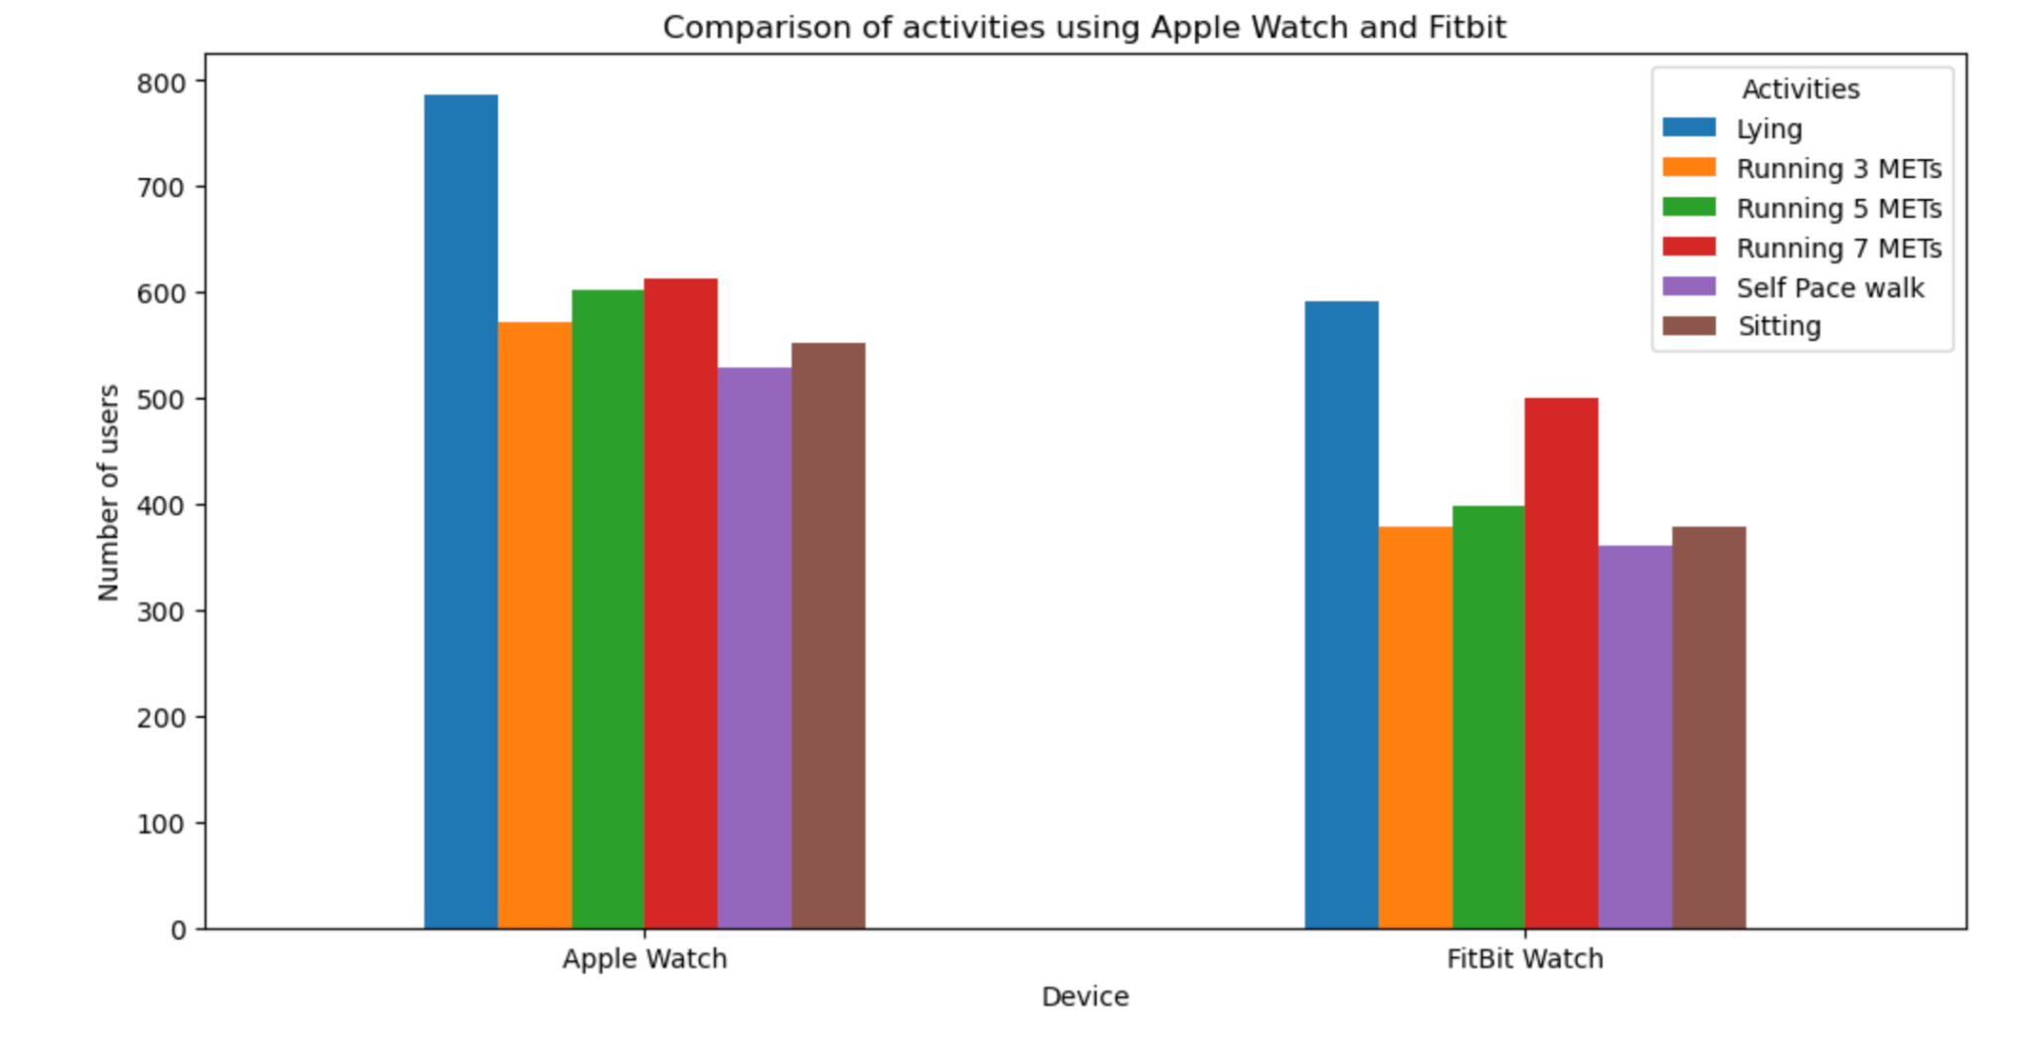
Comparison by activity
After merging two databases with over 6,264 Apple Watch and Fitbit users, the following analyses were conducted:
Activity Analysis: Identify 6 different activities as a preference.
Device Preference: Found a preference for Apple devices across different activities.
Activity Popularity: The most favored activity is "Lying," while the least popular is "Running at 7 METs."

Slide 6
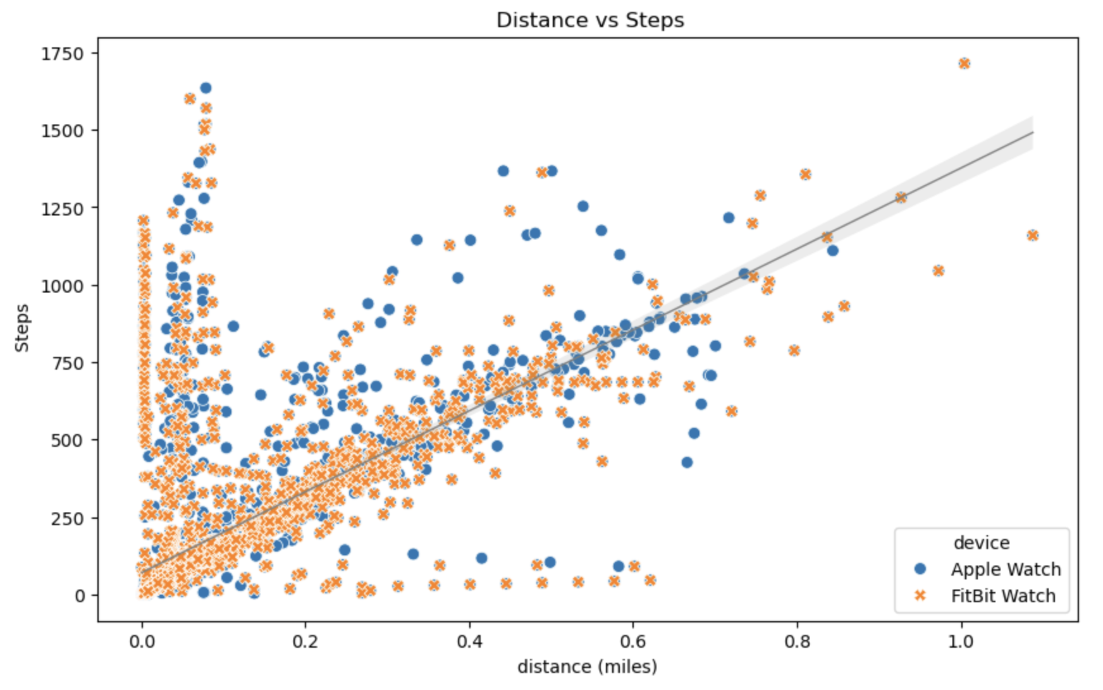
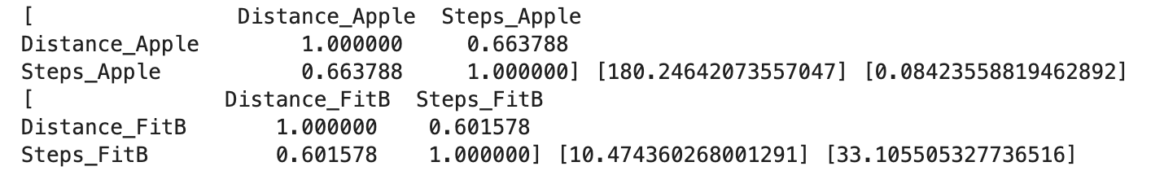
Frequency of use
We will identify the usage frequency by calculating steps and distance. In this analysis, aimed at determining how often users engage with their devices, we found:
The correlation between distance and steps is positive and exceeds 0.6 in both cases, with Apple devices showing a stronger correlation.
Apple users, on average, take more steps, but Fitbit users tend to cover greater distances during use.
This code efficiently processes and analyzes wearable device data by calculating key metrics such as average steps and distance.

Slide 7
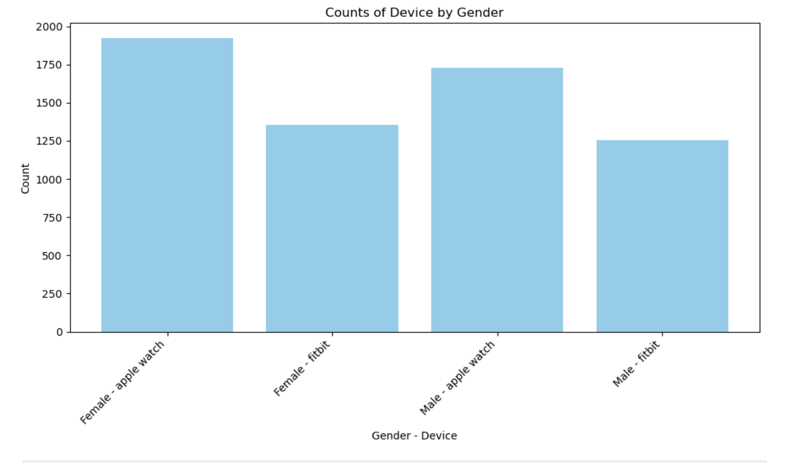
Gender preferences
The graph reveals a significant preference in for apple watch over fitbit among both genders. Without the presence of gender we can strongly say that Apple watch is viewed as the superior choice in a consumer standpoint.

Slide 8
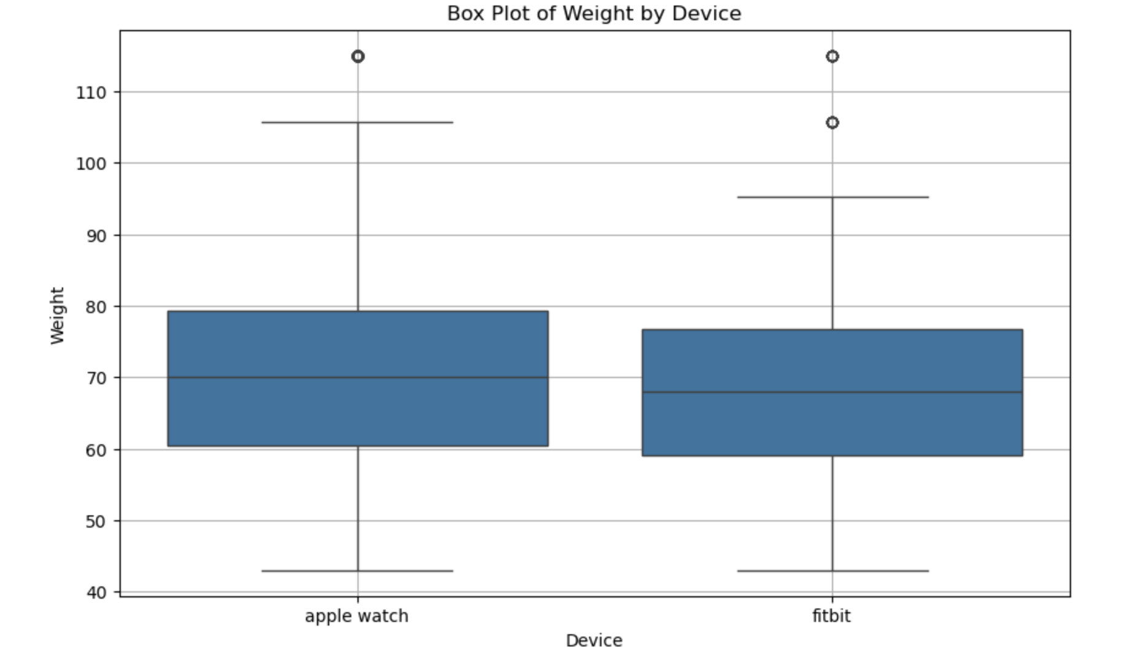
Distributed Weight
The box plots illustrate the distribution of weights among participants in the data collection. The data shows that Apple Watch users have a more varied weight distribution, indicating a broader range of body types within this group. In contrast, Fitbit users exhibit a more concentrated weight range. This suggests that while the user bases of both devices are similar in terms of average weight, the Apple Watch appeals to a more diverse demographic compared to the Fitbit.

Slide 9
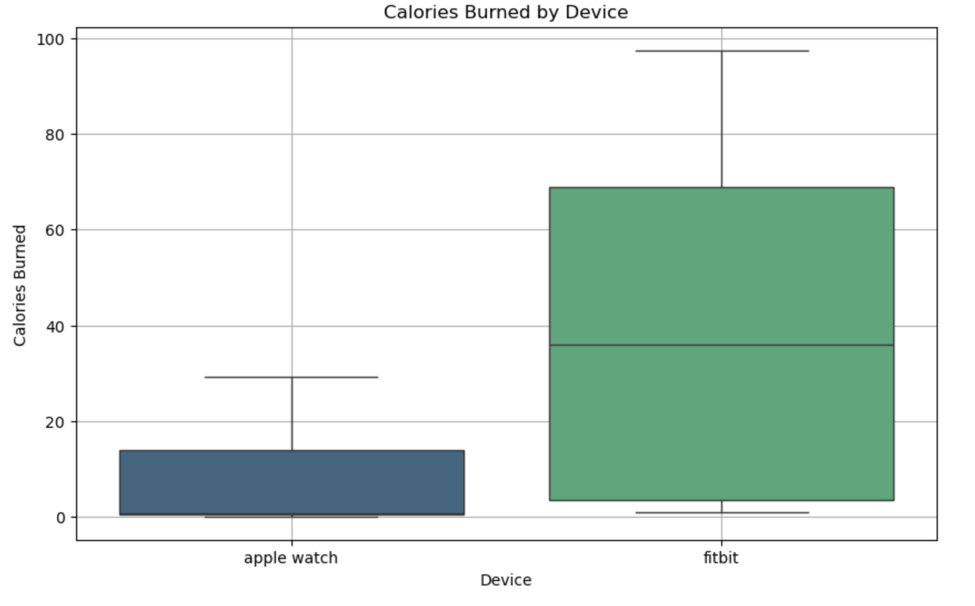
Calories Burned
The box plot reveals that Fitbit users burned more calories on average compared to Apple Watch users. This conclusion is drawn from the wider spread of the calorie burn data and the higher median value in the Fitbit user group. The larger range and higher median in the Fitbit box plot indicate that Fitbit users generally have higher calorie expenditure.

Slide 10
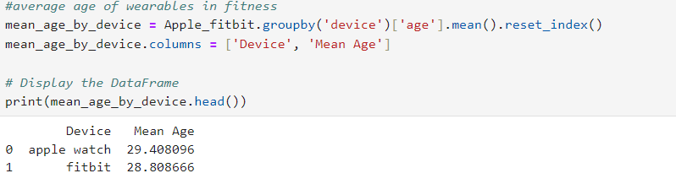
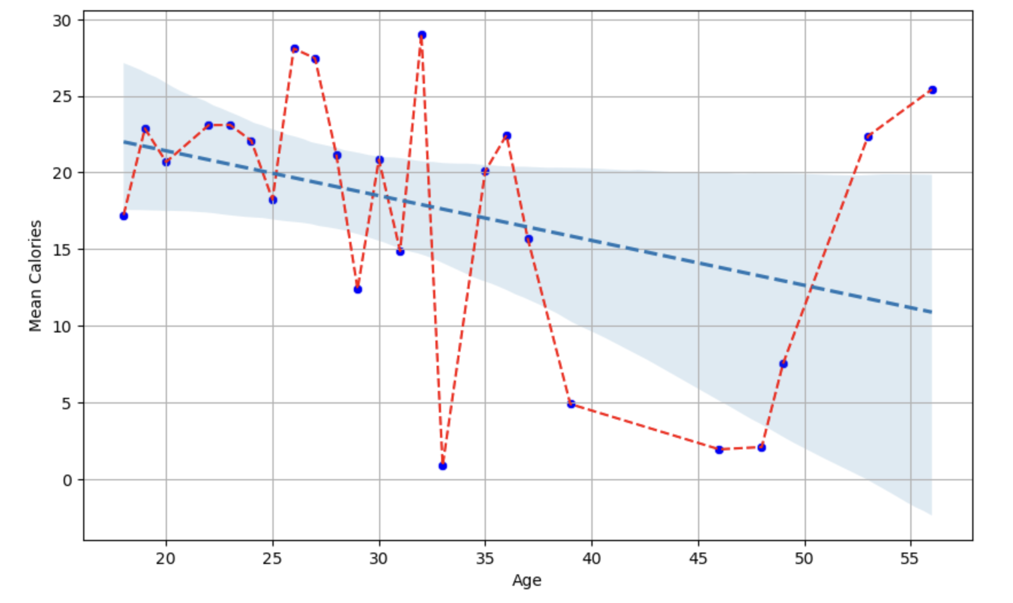
Relationship Between age and calories
Analyzing the mean age for each device reveals that the dataset is more representative of a younger demographic. This insight is supported by the scatter plot, which illustrates a trend of decreasing calorie consumption with increasing age. The scatter plot demonstrates a moderate negative correlation between age and calories burned, indicating that, on average, younger users tend to burn more calories compared to older users.

Slide 11
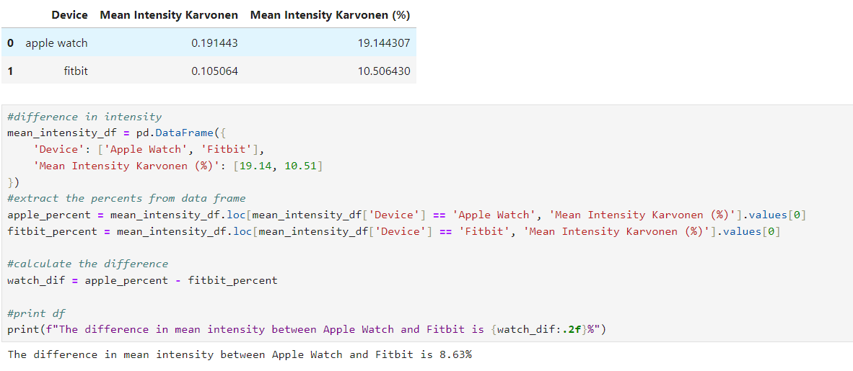
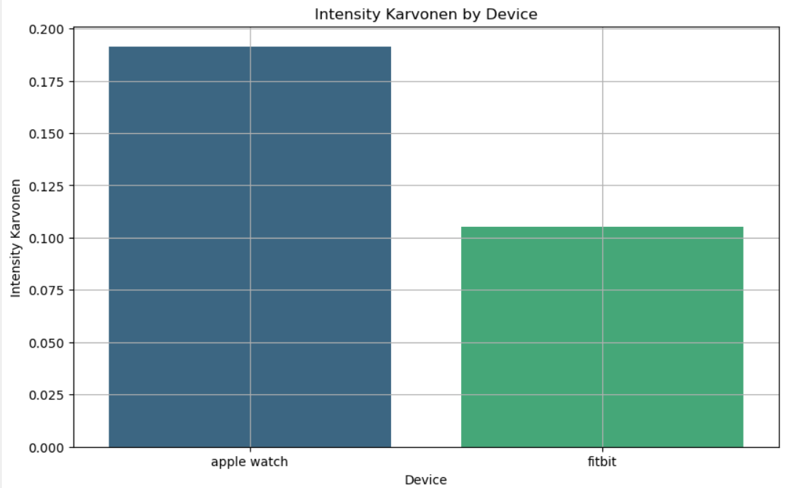
Wearable Intensity
The analysis reveals that Apple Watch users have an average heart rate intensity that is 20% above their resting rate, compared to 10% above for Fitbit users. This finding suggests that Apple Watch users tend to engage in more intense physical activity. For consumers interested in using wearable technology to support weight loss and enhance fitness, this data implies that the Apple Watch may offer a more intense fitness experience compared to the Fitbit.

Slide 12
Limitations
With the available resources for this data project we couldn't find a complete data set the would fit our requirements we have initially planned out. Only certain data sets had majority of the data points that we need to support our hypothesis stated earlier.
It was challenging to find data that provided details information on various devices used across different fitness activities. However, we were able to locate a dataset that includes two of thermos popular devices.
This Study does not offer insights into frequency of use for each gadget, so we had to rely on data related to steps and distance covered by users.

Slide 13
Conclusion
Our thorough analysis of the comprehensive data confirms that our hypothesis has been addressed.
Null Hypothesis: There is no significant improvement by less than 5% in the fitness world such as in one person's weight either using an Apple Watch or using a Fitbit.
Hypothesis: There is a significant improvement by more than 5% in the fitness world such as one person's weight either using an Apple Watch or using a Fitbit.
An intriguing observation from our analysis is that Apple Watch users exhibit 8.63% higher intensity in physical activity compared to Fitbit users. This suggests that Apple Watch users are more vigorous in their workouts. However, despite this higher intensity, Fitbit users tend to burn more calories over time. Consequently, it can be inferred that Fitbit users may experience greater improvements in weight management in the long run, even though Apple Watch users are more intense in their gym activities.
In understanding this data we acknowledged that lying down was an activity listed in the data frame if more time was allowed we would have placed a different activity to track more of a fitness aspect rather than a activity that takes little to no effort to do.

Slide 14
Conclusion Pt.2
In understanding this data we acknowledged that lying down was an activity listed in the data frame if more time was allowed we would have placed a different activity to track more of a fitness aspect rather than a activity that takes little to no effort to do. "Lying down" is a low-effort activity that does not contribute significantly to fitness measurements, so replacing it with a more relevant activity could enhance the accuracy of evaluating fitness levels and the effectiveness of the wearable devices.
Possible activity: Different exercise regimes (ex: weightlifting, pilates, yoga, cardio, bicycle )
By listing activities we could further test the effectiveness in wearables at the gym and track a more detailed data set that will help us support our hypothesis even more.

Slide 15
Thank you …

